Slide 1
Digital Image Processing
Notes:
These two things are self explain try

Slide 2
Digital Image (Recall)
A set of pixels (picture elements, pels)
Pixel means
  pixel coordinate
  pixel value
  or both
Both coordinates and value are discrete

Slide 3
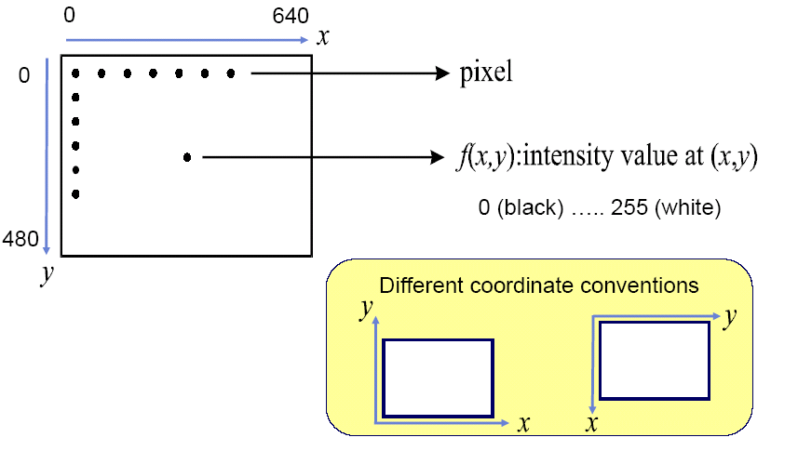
Example
640 x 480 8-bit image

Slide 4
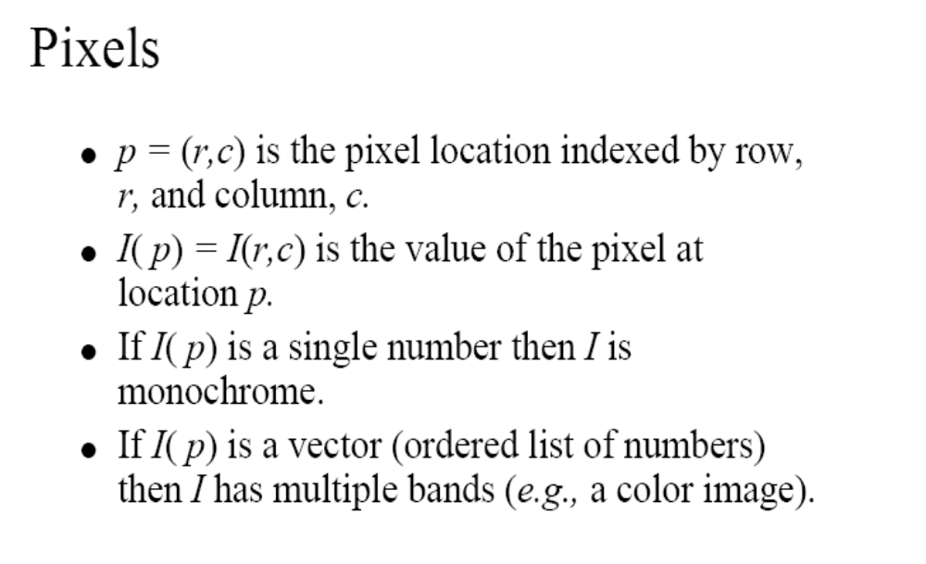

Slide 5
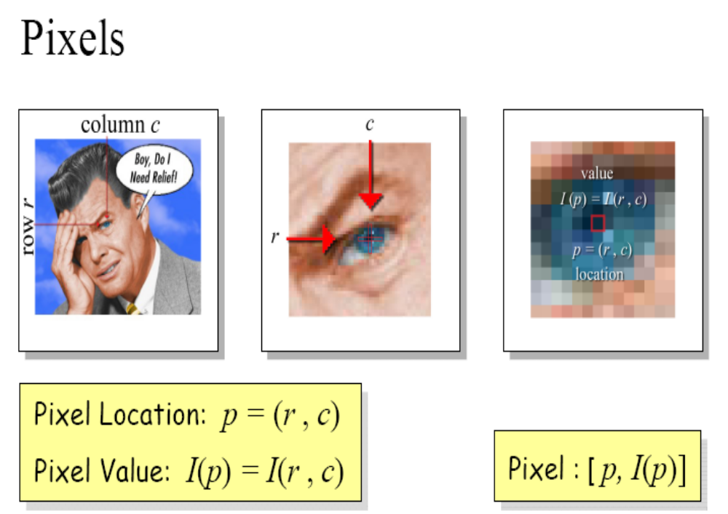

Slide 6
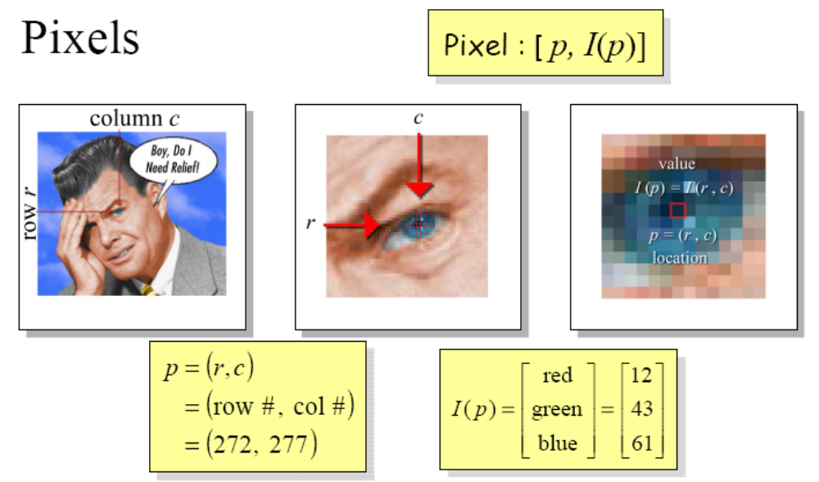

Slide 7
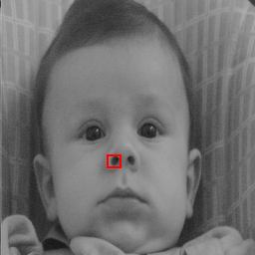
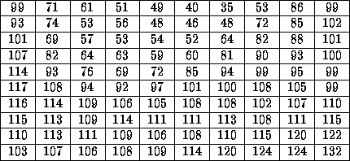
DIGITAL IMAGE REPRESENTATION
PIXEL VALUES IN HIGHLIGHTED REGION
A set of number in 2D grid
CAMERA
DIGITIZER
Samples the analog data and digitizes it.

Slide 8

AN EXAMPLE OF DIGITAL IMAGE ACQUISITION PROCESS

Slide 9
Image Formation and Acquisition
A digital image plane is acquired by recording a digital value proportional to the intensity of light (or other form of energy) impinging on each pixel of a detector
This intensity usually corresponds to the amount of light emitted by or reflected from a corresponding point on a specimen
0
0
0
1
0
0
0
0
3
7
8
3
0
0
0
6
8
8
8
2
0
0
2
8
8
8
4
0
0
0
4
8
8
3
0
0
0
0
2
1
0
0
Specimen
Projection of specimen
onto dectector grid
Image
Pixel
Notes:
Having an understanding of the specimen, the next step is the formation and acquisition of a digital image

Slide 10
Image Formation
Biological images may be acquired via a variety of imaging modes or modalities
Each mode is a combination of an image formation system and a detector
Sample
Image formation system
Detector

Slide 11

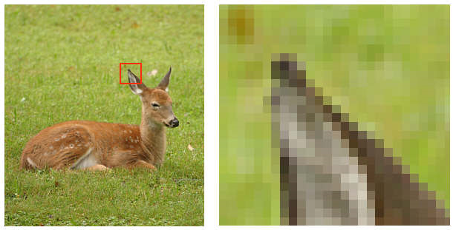
What is a Digital Image? (cont…)
Pixel values typically represent gray levels, colours.
Remember digitization implies that a digital image is an approximation of a real scene
1 pixel

Slide 12
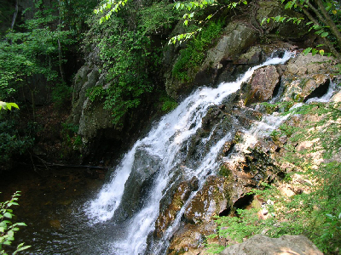
What is a Digital Image? (cont…)
Common image formats include:
  1 sample per point (B&W or Grayscale)
  3 samples per point (Red, Green, and Blue)
For most of this course we will focus on grey-scale images

Slide 13
BRIGHTNESS ADAPTATION AND DISCRIMINATION
The human visual system can perceive approximately 10¹⁰ different light intensity levels
However, at any one time we can only discriminate between a much smaller number – brightness adaptation

Slide 14
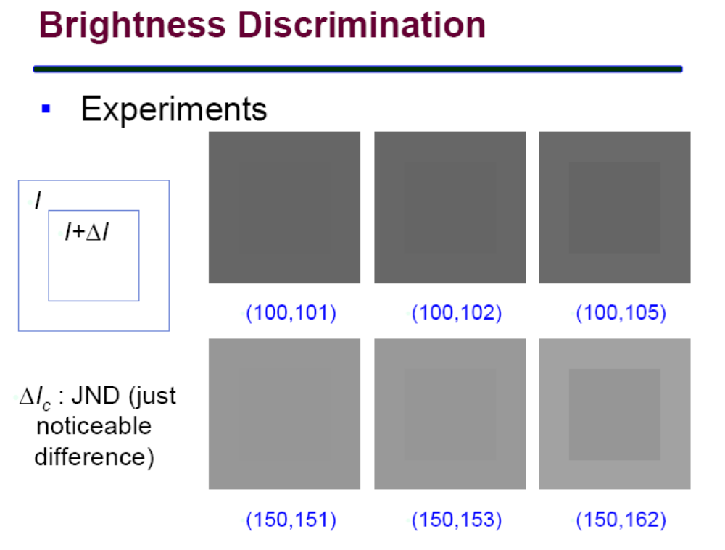

Slide 15
CONTRAST SENSITIVITY
I+ΔI_{c}
The ability of the eye to discrimination b/w changes in brightness at any specific adaptation level is of considerable interest.
I is uniformly illuminated on a flat area large enough to occupy the entire field of view.
ΔI_{c} is the change in the object brightness required to just distinguish the object from the background
I
Weber's ratio: ΔI_{c}/I
Good brightness discrimination
 ΔI_{c}/I is small.
Bad brightness discrimination
 ΔI_{c}/I is large.

Slide 16
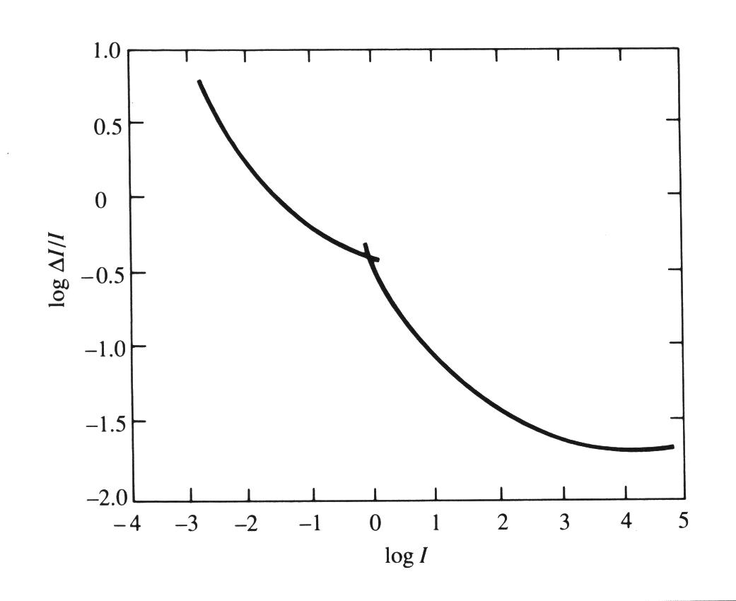
WEBER RATIO
Good
Brightness discrimination is poor (the weber ratio is large),
at low levels of illumination and improves significantly (the ratio decreases) as background illumination increases.
rods
cones
discrimination
Poor
Low
High
level illumination
Weber ratio as a function
of log intensity.

Slide 17
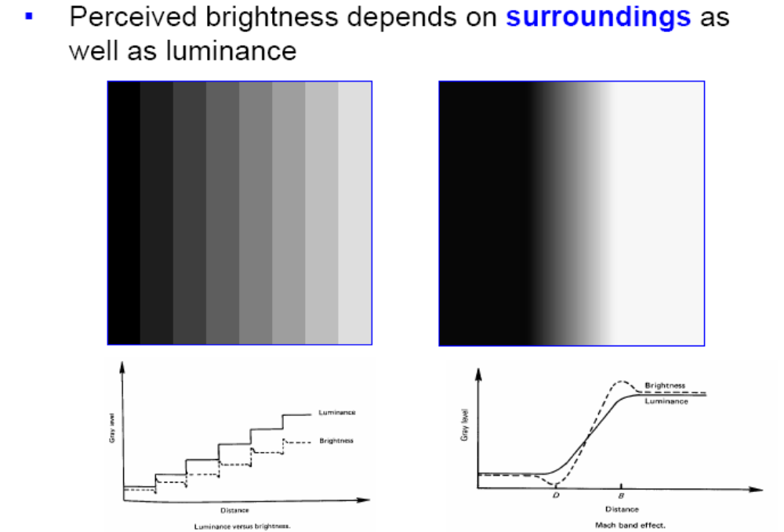
MACH BANDS
The intensity of the stripes is constant but we actually perceive a brightness pattern which is strongly scalloped near the boundaries.

Slide 18
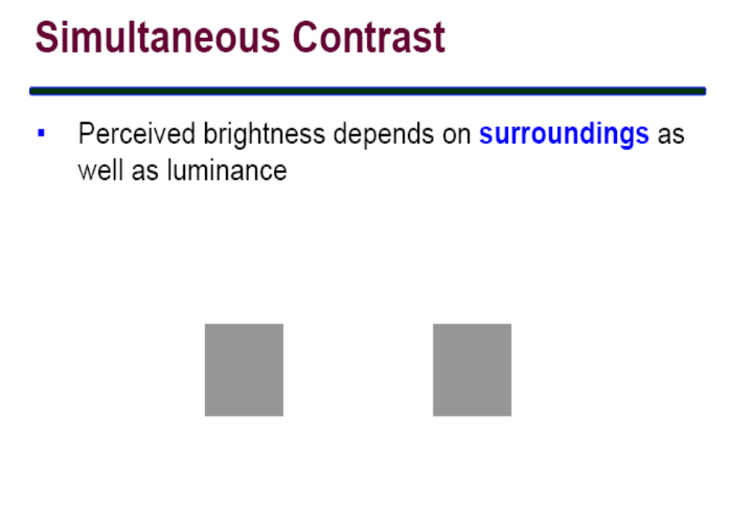

Slide 19
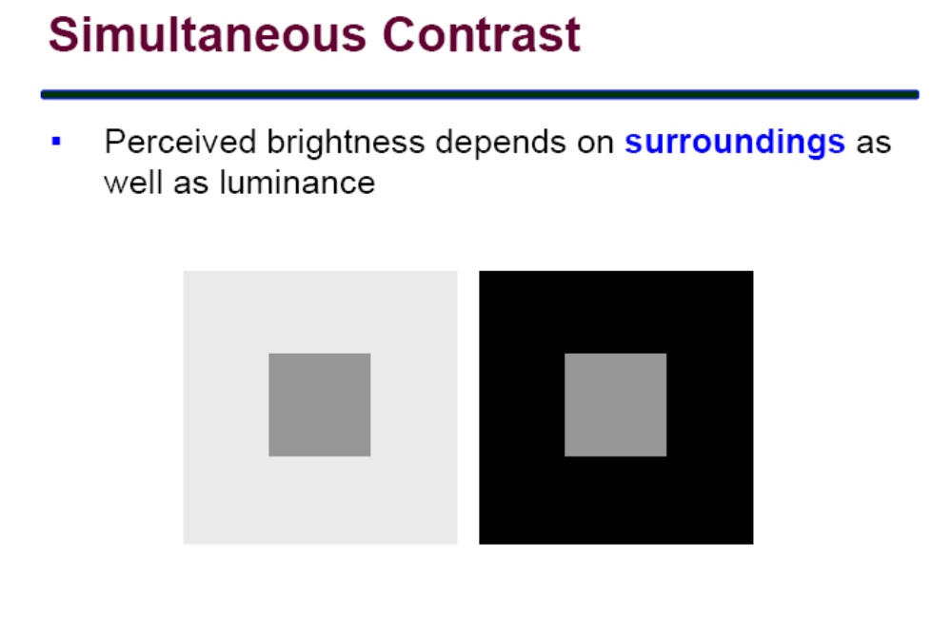

Slide 20
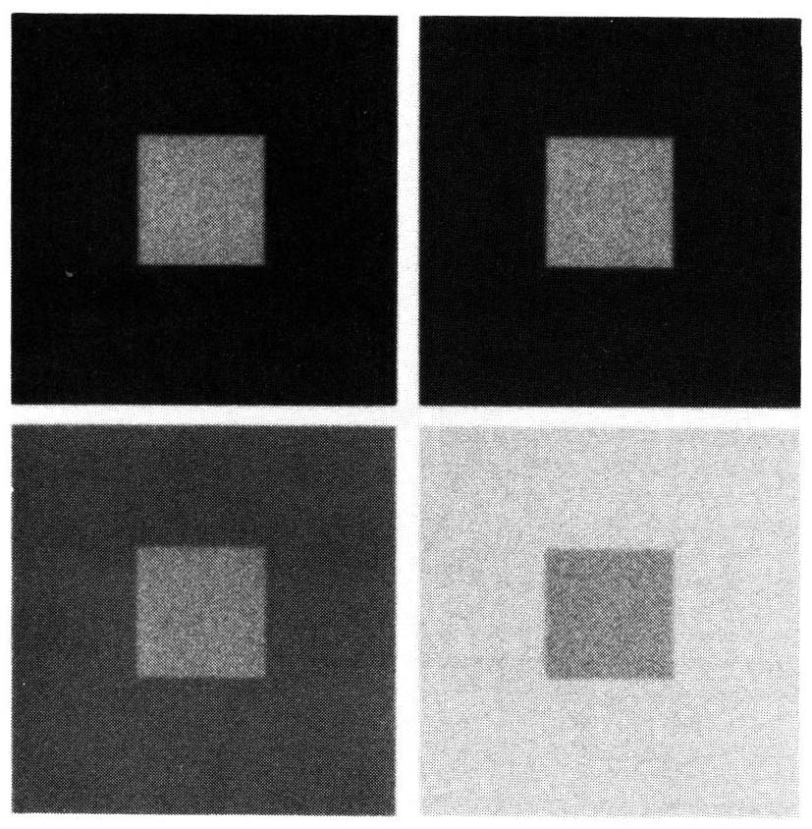
SIMULTANEOUS CONTRAST
Which small square is the darkest one ?
All the small squares have exactly the same intensity, but they appear to the eye progressively darker as the background becomes brighter.
Region’s perceived brightness does not depend simply on its intensity.
Test yourself.

Slide 21
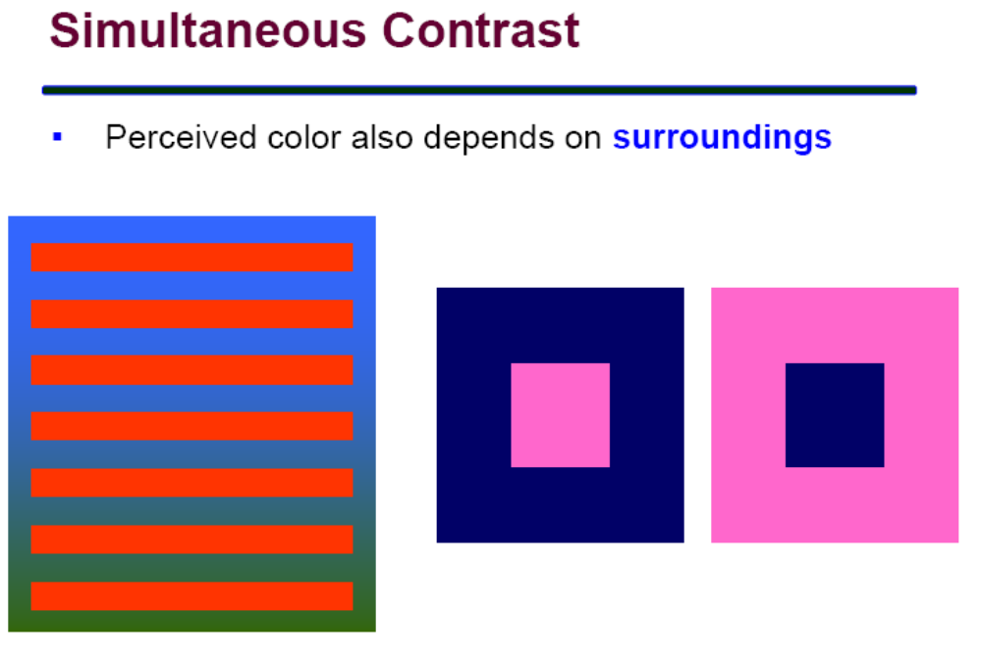

Slide 22
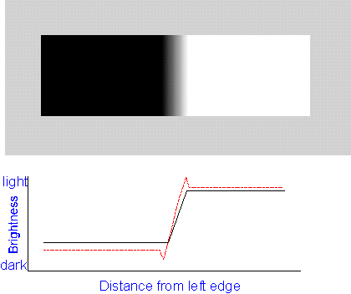

Psychovisual effects
The perceived brightness is not a simple function of intensity
  Mach band pattern
  Simultaneous contrast

Slide 23
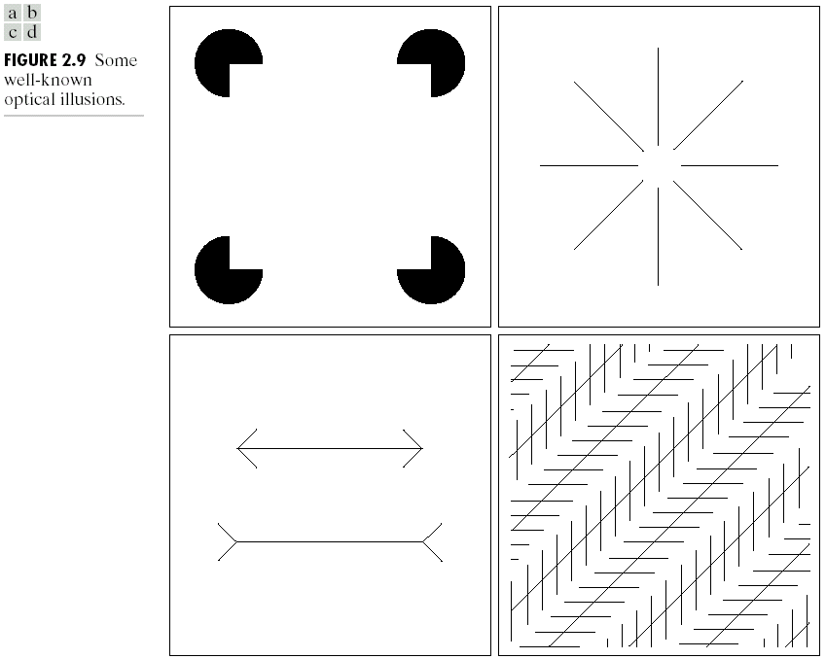
OPTICAL ILLUSIONS

Slide 24
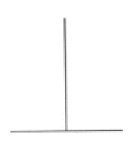

Test images for distances and area estimation
The vertical line appears longer but actually has the same length as the horizontal line.
Deception by perspective: the upper line appears longer than the lower one but actually have the same length

Slide 25

VISUAL ILLUSION
Which lines are straight?

Slide 26
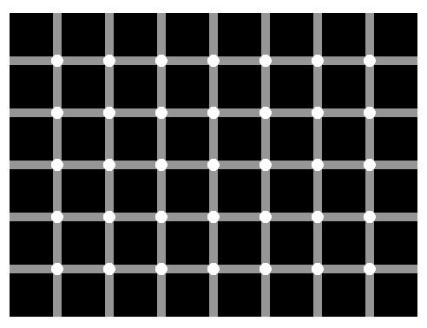
VISUAL ILLUSION
Find the black dot

Slide 27
AN EXAMPLE OF DIGITAL IMAGE ACQUISITION PROCESS

Slide 28
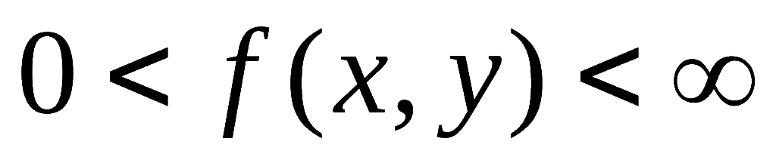
IMAGE FORMATION MODEL
IMAGE REFERS TO A 2D LIGHT-INTENSITY FUNCTION, f(x, y)
THE AMPLITUDE OF f AT SPATIAL COORDINATES (x, y) GIVES THE INTENSITY (BRIGHTNESS) OF THE IMAGE AT THAT POINT.
Light is a form of energy thus f(x, y) must be nonzero and finite.
The function f(x, y) may be characterized by two components:
  The amount of source light incident on the scene being viewed ⇨ illumination.
  The amount of light reflected by the objects in the scene ⇨ reflectance.

Slide 29
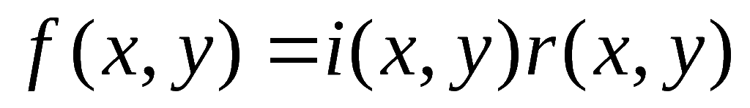
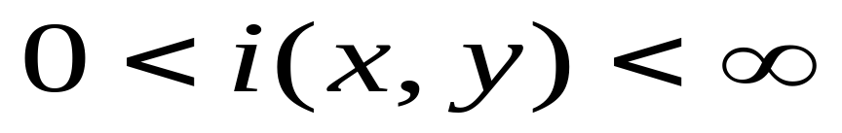
ILLUMINATION AND REFLECTANCE
DETERMINED BY THE NATURE OF THE LIGHT SOURCE
DETERMINED BY THE NATURE OF THE OBJECTS IN A SCENE ⇨ BOUNDED FROM TOTAL ABSORPTION TO TOTAL REFLECTANCE.

Slide 30
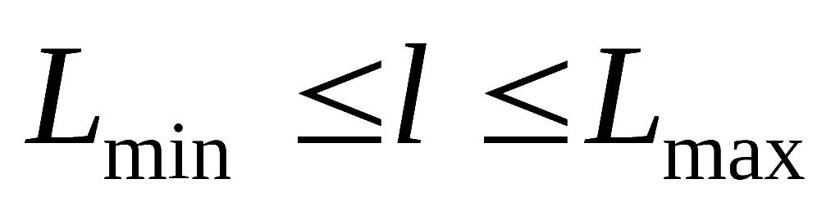
GRAY LEVEL
WE CALL THE INTENSITY OF A MONOCHROME IMAGE f AT COORDINATE (x, y) THE GRAY LEVEL (L) OF THE IMAGE AT THAT POINT.
Thus, l lies in the range
L_{min} is positive and l_{max} is finite.
Gray scale = [l_{min}, l_{max}]
Common practice, shift the interval to [0,l] : 0 = black, l-1 = white

Slide 31
TYPES OF SIGNALS:ANALOG & DIGITAL
Most naturally-occurring signals also have a real-valued range in which values occur with infinite precision.
To store and manipulate signals by computer we need to store these numbers with finite precision. Thus, these signals have a discrete range.
Signal has continuous domain and range = analog.
Signal has discrete domain and range = digital.

Slide 32
SAMPLING
Sampling = The spacing of discrete values in the domain of a signal.
Sampling-rate = How many samples are taken per unit of each dimension. e.g., Samples per second, frames per second, etc.
f(t)
t

Slide 33

QUANTIZATION
Quantization = Spacing of discrete values in the range of a signal.
Usually thought of as the number of bits per sample of the signal. e.g., 1 bit per pixel (b/w images), 16-bit audio, 24-bit color images, etc.
f(t)
7
8 levels = 2³ : uses 3 bits to represent the value of the function.
t
0

Slide 34
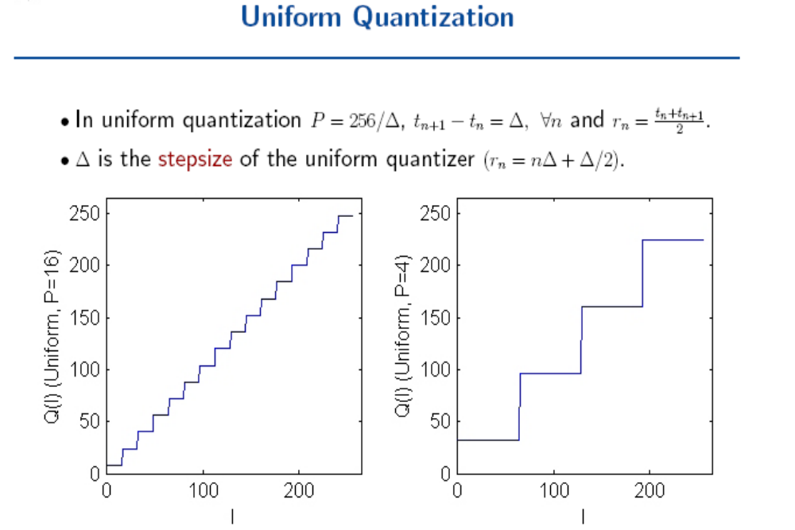

Slide 35
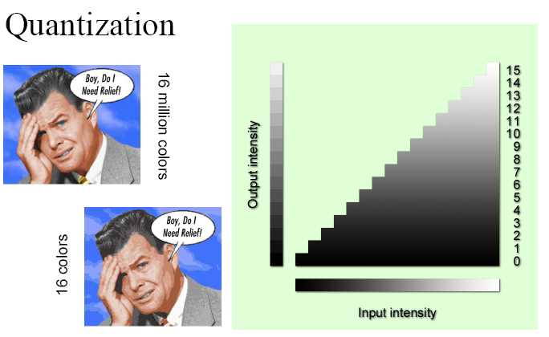

Slide 36
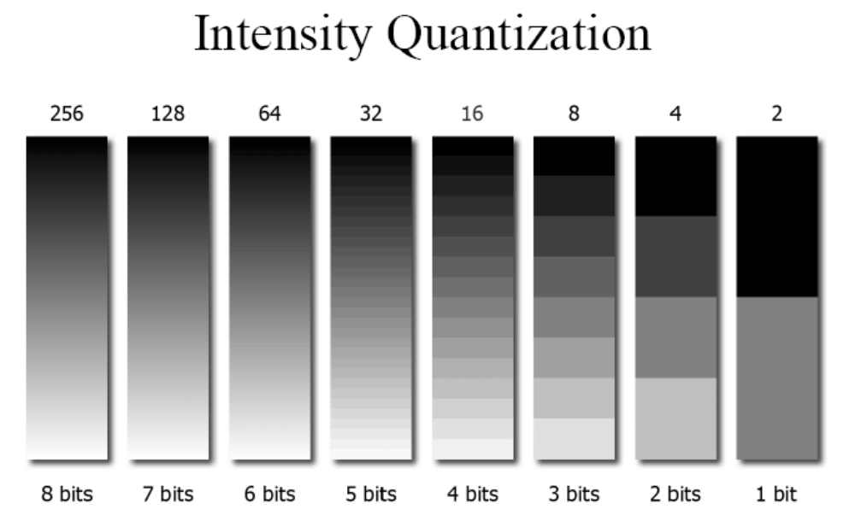

Slide 37
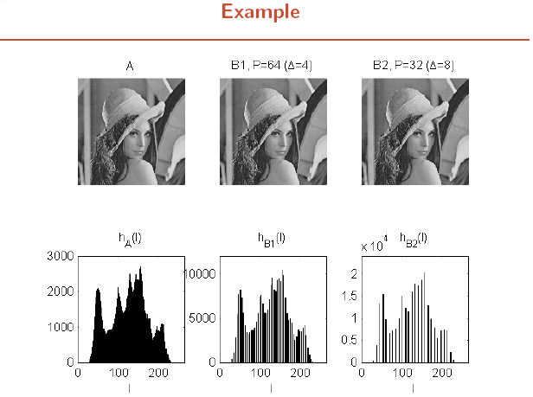

Slide 38
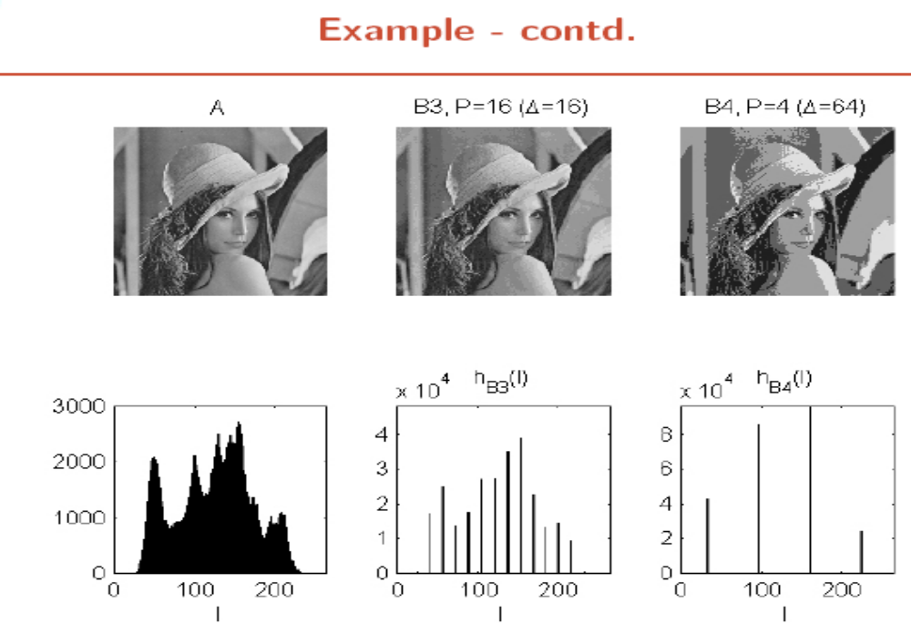

Slide 39

SAMPLING AND QUANTIZATION

